Slide 1
Bridging research & application in dairy cattle breeding
John B. Cole, Christian Maltecca, Christine F. Baes, and Jicai Jiang
FarmGTEx Project Workshop, PAG 33 | January 12, 2026

Slide 2
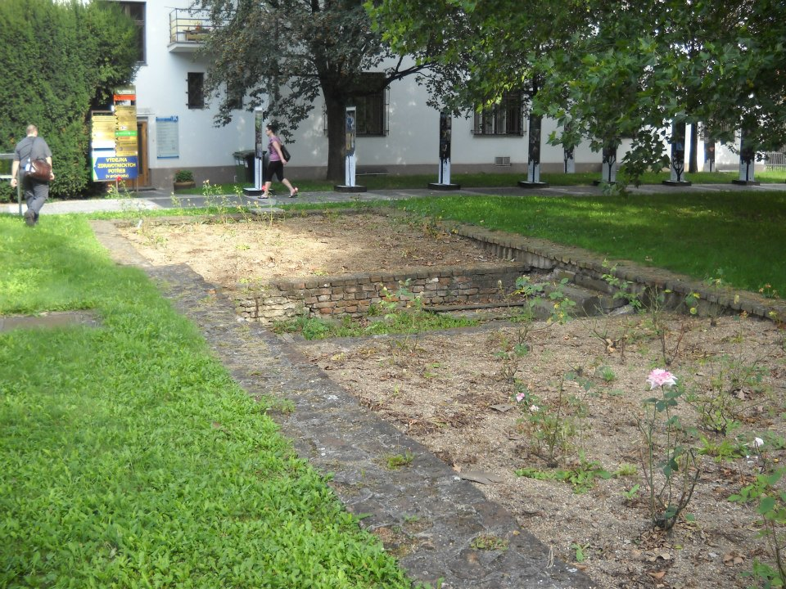
Overview
Genetic defects in dairy cattle breeding
Conventional management tools
Next-generation tools
AI/ML tools for prediction
Closing thoughts

Slide 3
Genetic defects in dairy cattle breeding

Slide 4
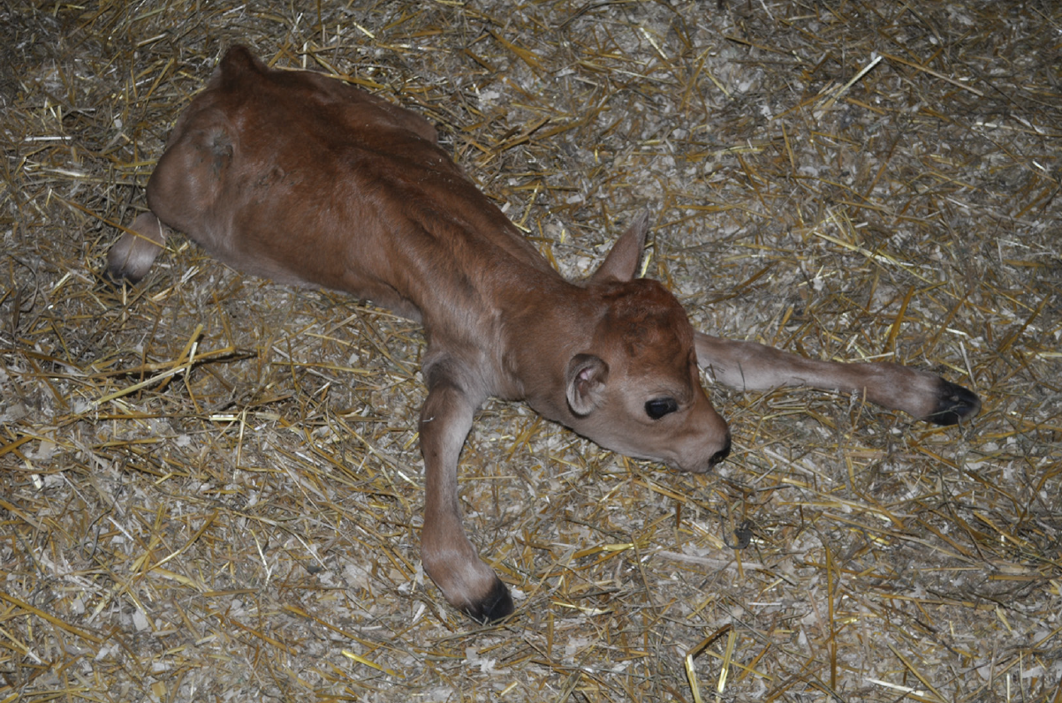
Genetic defects
Presentation varies widely, from gross congenital malformation to subtle physiological differences
The worst defects result in the birth of lives calves which must be euthanized
May result from large or small changes in DNA
A Jersey calf homozygous for neuropathy with splayed forelimbs (American Jersey Cattle Association, Reynoldsburg, OH).

Slide 5

There are many known genetic defects
There are 698 genetic traits/disorders of cattle in the “Online Mendelian Inheritance in Animals” database (03/30/2025)
    https://omia.org/home/
273 of these are Mendelian traits/disorders

Slide 6
Known recessives in US Holsteins (August 2024)
Defect | OMIA ID | Year | Identifier |  | Gene name |  | Frequency (%) | Chromosome | Location (bp)
Bovine leukocyte adhesion deficiency (BLAD) | 000595 | 1983 | HHB |  | ITGB2 |  | 0.03 | 1 | 144,770,078
Bovine lymphocyte intestinal retention defect (BLIRD) | 002872 | 2023 | — |  | ITGB7 |  | — | 5 | 26,807,079
Brachyspina | 000151 | 2006 | HH0 |  | FANCI |  | 0.28 | 21 | 20,775,563
Cholesterol deficiency | 001965 | 2015 | HCD |  | APOB |  | 0.34 | 11 | 77,872,709
Complex vertebral malformation | 001340 | 2000 | HHC |  | SLC35A3 |  | 0.25 | 3 | 43,261,946
Deficiency of uridine monophposphate synthase (DUMPS) | 000262 | 1983 | HHD |  | UMPS |  | <0.01 | 1 | 69,151,931
Early onset muscle weakness syndrome | 002819 | 2022 | HMW |  | CACNA1S |  | 2.04 | 16 | 79,613,592
Holstein Haplotype 1 | 000001 | 2011 | HH1 |  | APAF1 |  | 0.40 | 5 | 62,810,245
Holstein Haplotype 2 | 001823 | 2011 | HH2 |  | IFT80 |  | 0.68 | 1 | 107,172,615
Holstein Haplotype 3 | 001824 | 2011 | HH3 |  | SMC2 |  | 0.65 | 8 | 93,753,358
Holstein Haplotype 4 | 001826 | 2013 | HH4 |  | GART |  | 0.09 | 1 | 1,997,582
Holstein Haplotype 5 | 001941 | 2013 | HH5 |  | TFB1M |  | 2.50 | 9 | 91,847,117– 91,937,003
Holstein Haplotype 6 | 002149 | 2018 | HH6 |  | SDE2 |  | 1.14 | 16 | 29,773,628
Holstein Haplotype 7 | 001830 | 2020 | — |  | CENPU |  | 0.80 | 27 | 14,168,130–14,168,133
Holstein Haplotype 8 | 001831 | 2013 | — |  | — |  | 2.10 | 7 | 78,800,000–80,100,000
Mulefoot (syndactylism) | 000963 | 1949 | HHM |  | LRP4 |  | <0.01 | 15 | 76,807,960

Slide 7
Conventional management tools

Slide 8
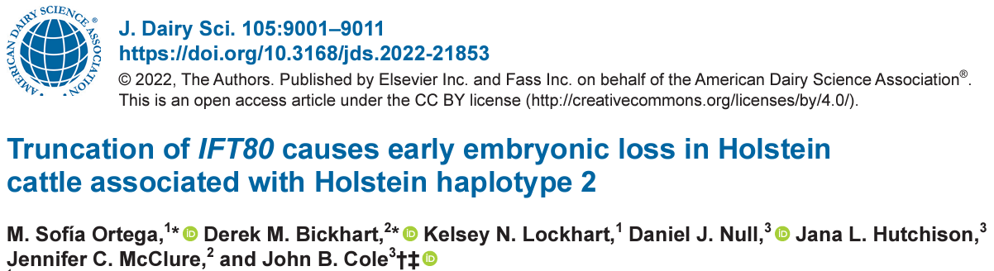
Validation of candidate HH2 variant
IFT80-null embryos generated by truncation at exon 2 with guide-RNAs annealed to Cas9 mRNA
Abattoir-derived oocytes fertilized in vitro with high-fertility semen
Embryos injected at the one-cell stage with CRISPR-Cas9 complex (treatment) or Cas9 mRNA(control) before return to culture
IFT80-null embryos arrested at
the 8-cell stage of development

Slide 9
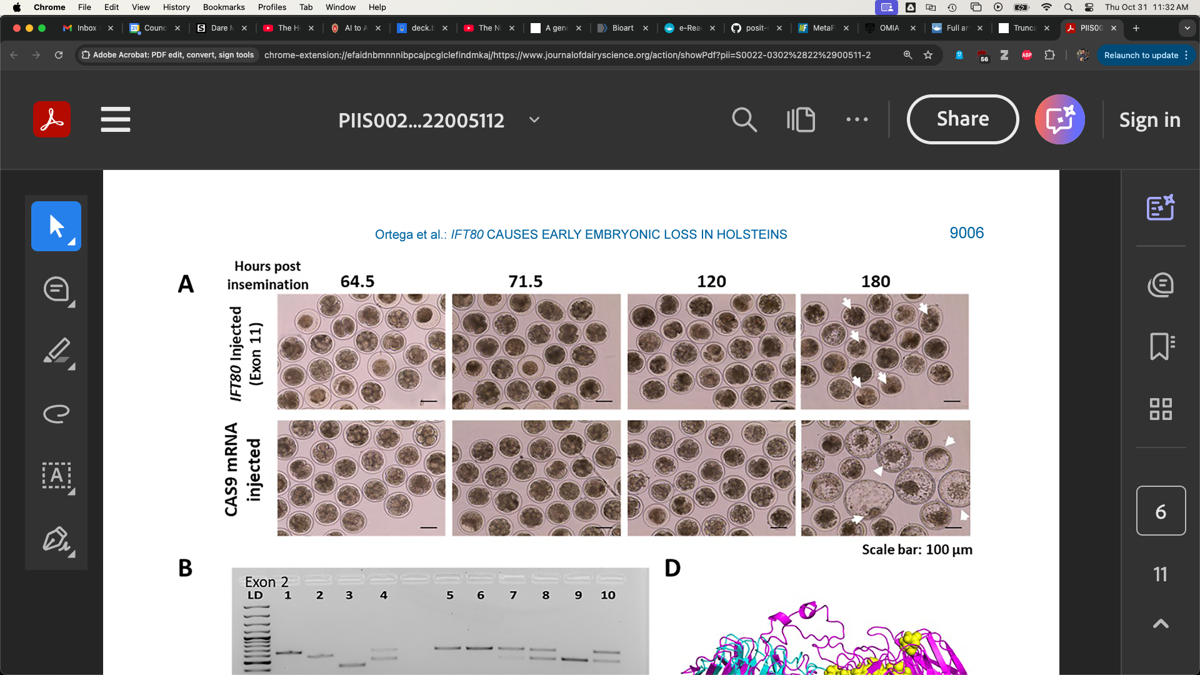
Oh no, the poor treatment embryos!
Control embryos injected with only Cas-9 (left)
A frameshift in IFT80 at 107,172,615 bp (p.Leu381fs) disrupts wnt and hedgehog signaling
A tag SNP is now used to track the causal mutation
Proven sires should be genotyped to confirm concordance
Treatment embryos injected with Cas-9 and IFT80 exon 2 guide RNA (right)

Slide 10
How should we manage diversity?
There are many tools nobody uses
Many cows are mated at random to
a portfolio of bulls
Everyone’s else should use
different bulls
Can a machine learning model do
a better job of mating? Will anyone use it if it does?
Some ways to avoid inbreeding
Optimal contribution theory
Minimization of progeny inbreeding
Linear programming
Look-ahead mate selection
Selection against lethal alleles
Index selection including Mendelian sampling variance
Genomic selection including dominance

Slide 11
Next-generation tools

Slide 12
FarmGTEx provides a better roadmap
More complex variants
Differential expression in time and/or space
Gene-editing targets
Validation of organoid models
Context for training and interpreting AL/ML models
Fang et al., 2025,
https://doi.org/10.1038/s41588-025-02121-5

Slide 13
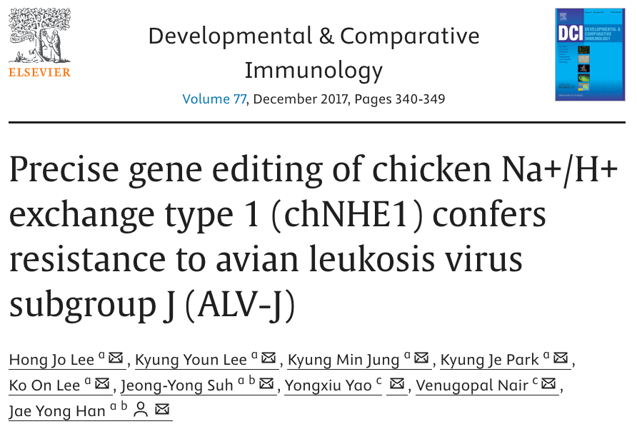
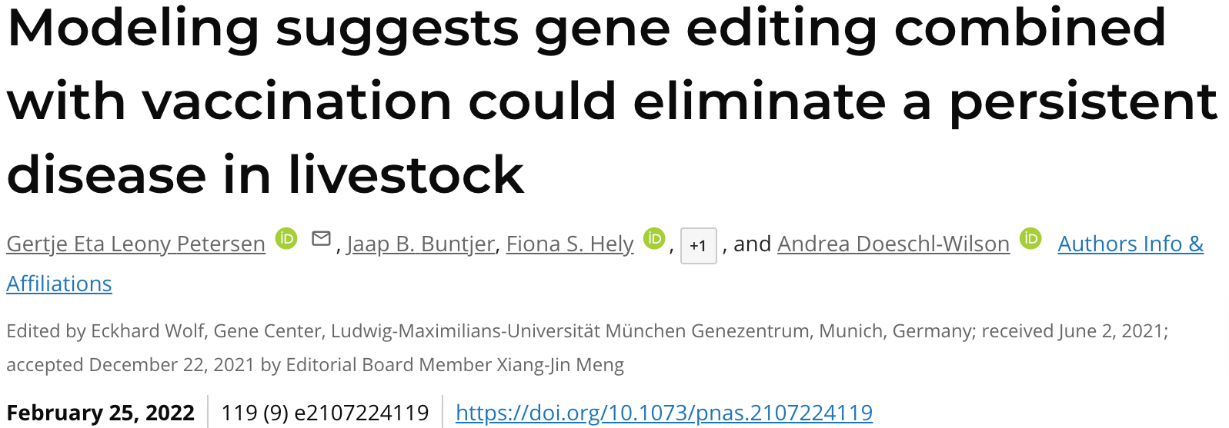
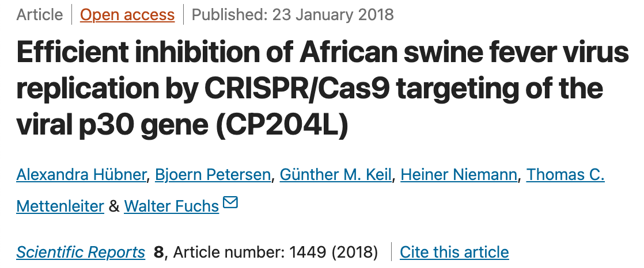
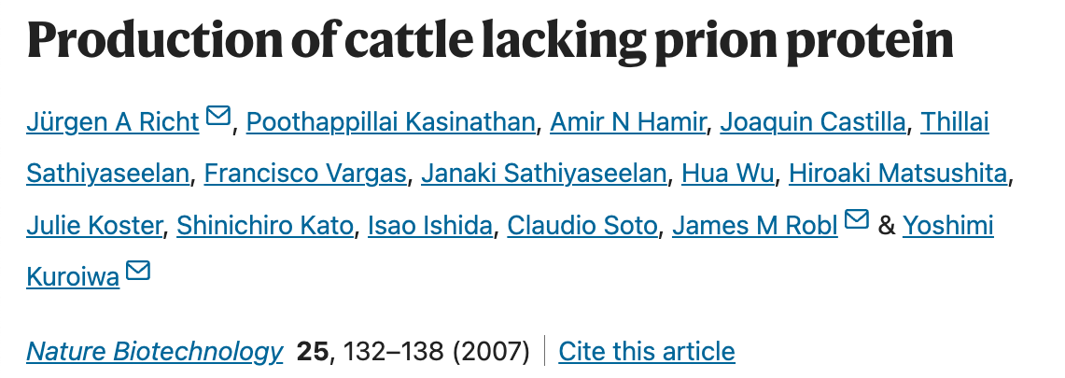
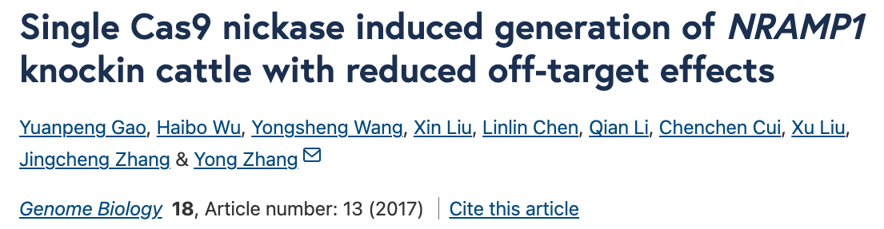
Maybe we’ll edit them away

Slide 14
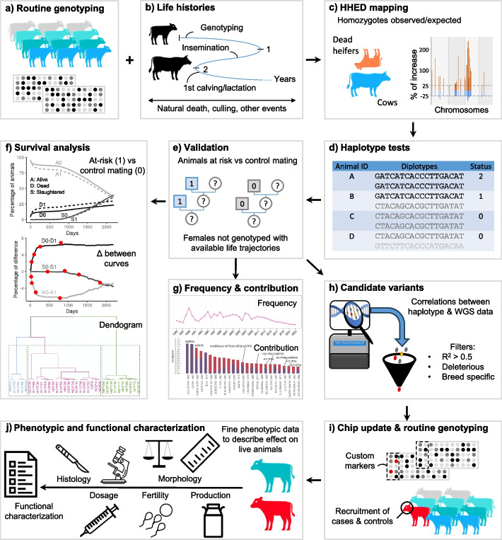
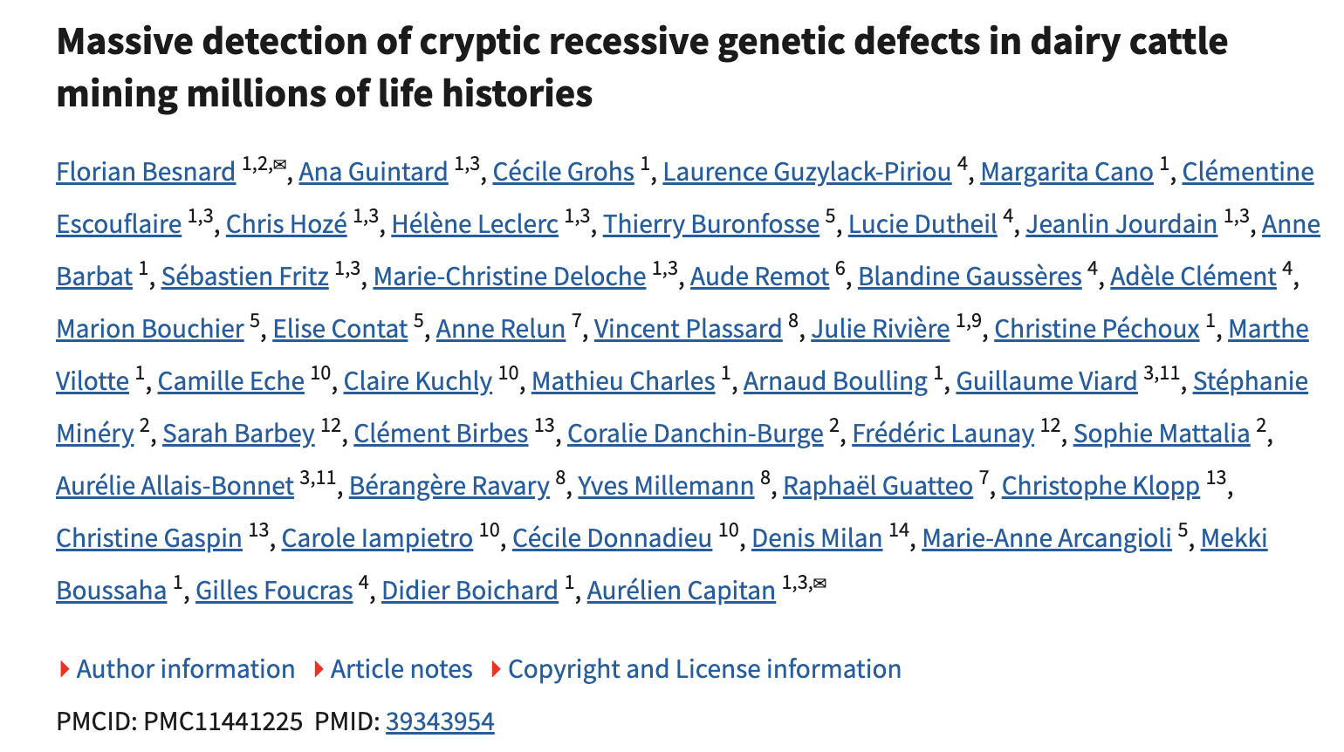

Next-generation in silico discovery

Slide 15

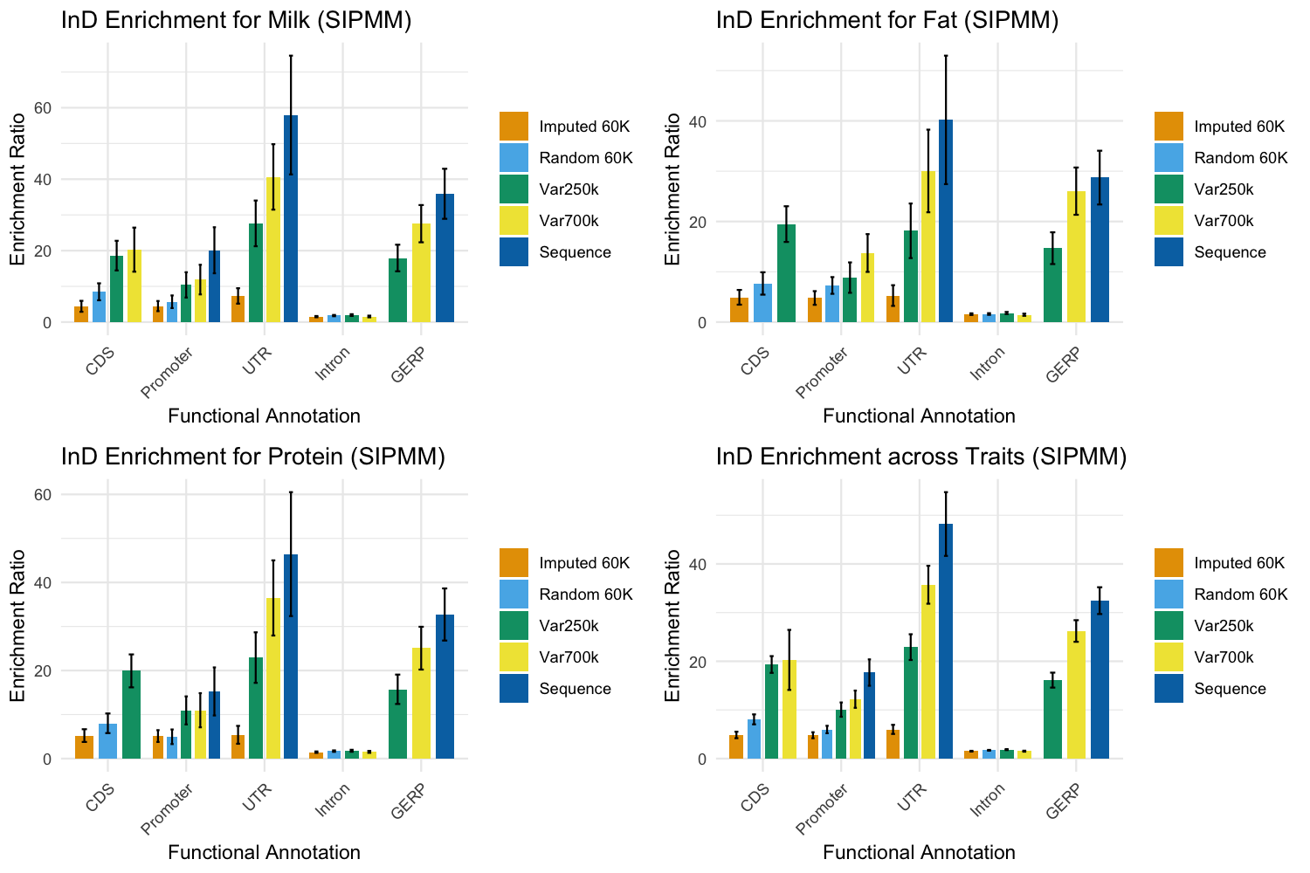



Genomic partition of inbreeding depression
Overview:
  Analyzed 245,517 genotyped Jersey cows using a linear mixed model.
  Mapped 9,532,696 sequence variants into
  five functional annotations: Intron, Promoter, GERP, CDS, UTR, and others.
Key Findings:
  Significant enrichment of InD for milk yield in promoter (enrichment ratio = 20.11), UTR (57.96), and GERP regions (35.91).
  Protein yield showed enrichment in promoter (15.25), UTR (46.44), and GERP regions (32.73).
  Fat yield showed enrichment in UTR (40.20) and GERP regions (28.72).
Xu et al., 2025, https://doi.org/10.3168/jds.2025-26738

Slide 16
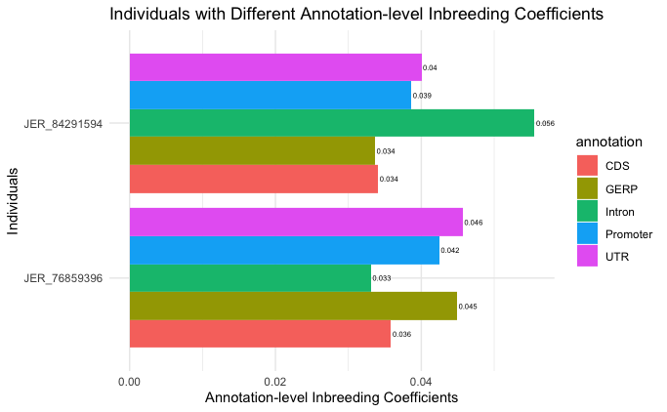

Genomic partition of inbreeding depression
Conclusion:
  Some genome annotations have disproportionate effects on inbreeding depression (InD).
  These regions may be more vulnerable to mutations.
Implications:
  Enhances understanding of genetic basis of InD.
  Could inform breeding strategies for dairy cattle.
Xu et al., 2025, https://doi.org/10.3168/jds.2025-26738

Slide 17
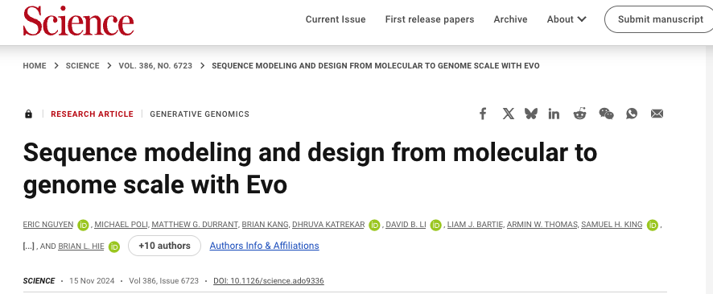


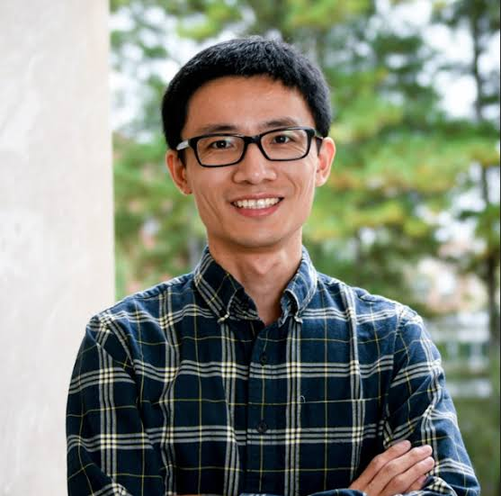
EVO2 proof-of-concept
chicken | dog | cat | goat | horse | pig | sheep | cattle
27 | 248 | 111 | 7 | 71 | 29 | 60 | 168
Single Locus Diseases Variants
Disease
EVO2
Anonymized
Control Variants
Neutral
Jicai Jiang

Slide 18
We can predict deleterious variants in bulls with a LLM
test_species | Variant-type blind |  | Variant-type matching
 | AUROC | AUPRC | AUROC | AUPRC
chicken | 0.8438 | 0.3740 | 0.6126 | 0.1645
dog | 0.9133 | 0.5817 | 0.7738 | 0.2674
cat | 0.8969 | 0.5518 | 0.6832 | 0.2008
goat | 0.8714 | 0.5606 | 0.6571 | 0.3557
horse | 0.9307 | 0.5590 | 0.8276 | 0.2942
pig | 0.9310 | 0.6070 | 0.8430 | 0.3925
sheep | 0.8954 | 0.5574 | 0.6753 | 0.2524
cattle | 0.8958 | 0.5077 | 0.7438 | 0.2672
AVERAGE | 0.8973 | 0.5374 | 0.7271 | 0.2744

Slide 19
AI/ML tools for prediction

Slide 20
Do these models improve genetic predictions?
AI models do not routinely perform better than linear models for genomic prediction in dairy cattle (Wang et al., 2022; Chafai et al., 2023; Florent, 2025; Morota et al., 2026)
Machine learning models may perform better than genomic BLUP in other species or when datasets are very small (Wang et al., 2022; Hayes et al., 2023; Wang et al., 2024)

Slide 21
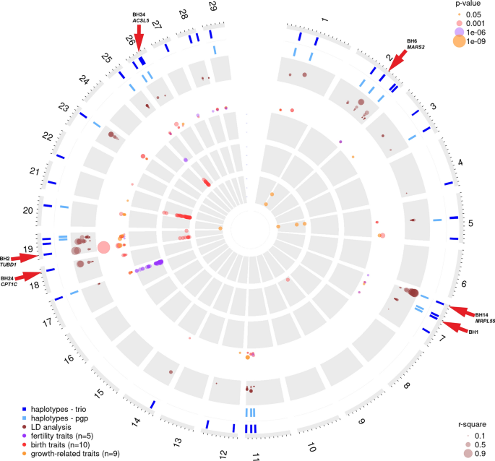
Imputation is expensive
Existing genotypes must be re-imputed when new haplotypes are found
This is expensive for large populations
Machine learning models may be able to call carriers without re-imputation
Häfliger et al. (2021)

Slide 22
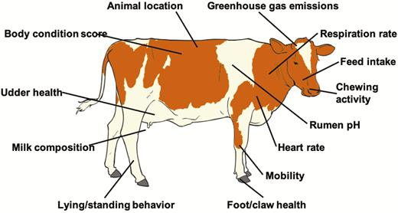
Where are opportunities for prediction?
High-throughput generation of digital phenotypes
Identification of complex relationships (e.g., G2P)
Prediction of phenotypic performance
On-farm decision support
Cole et al. (2020)

Slide 23
Closing thoughts
Potential to uncover patterns that are difficult for humans to see in large data
Do these models provide repeatable results?
  An animal has only one true genotype
  An animal has only one true breeding value for a trait
Costs associated with these new tools are unclear
“Black boxes” aren’t very scientific

Slide 24
Acknowledgments
John B. Cole – Council on Dairy Cattle Breeding; University of Florida; North Carolina State University; University of Guelph
Christian Maltecca – North Carolina State University; University of Guelph
Christine F. Baes – University of Guelph; University of Bern
Jicai Jiang – North Carolina State University

Slide 25
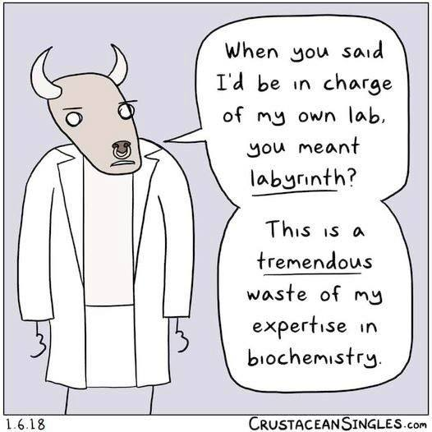
CDCB is accepting applications for summer interns! https://uscdcb.com/careers/
Thank you for your
attention!
john`.cole@uscdcb.com

